Slide 1
BATTAMBANG PROVINCE CAMBODIA

Slide 2
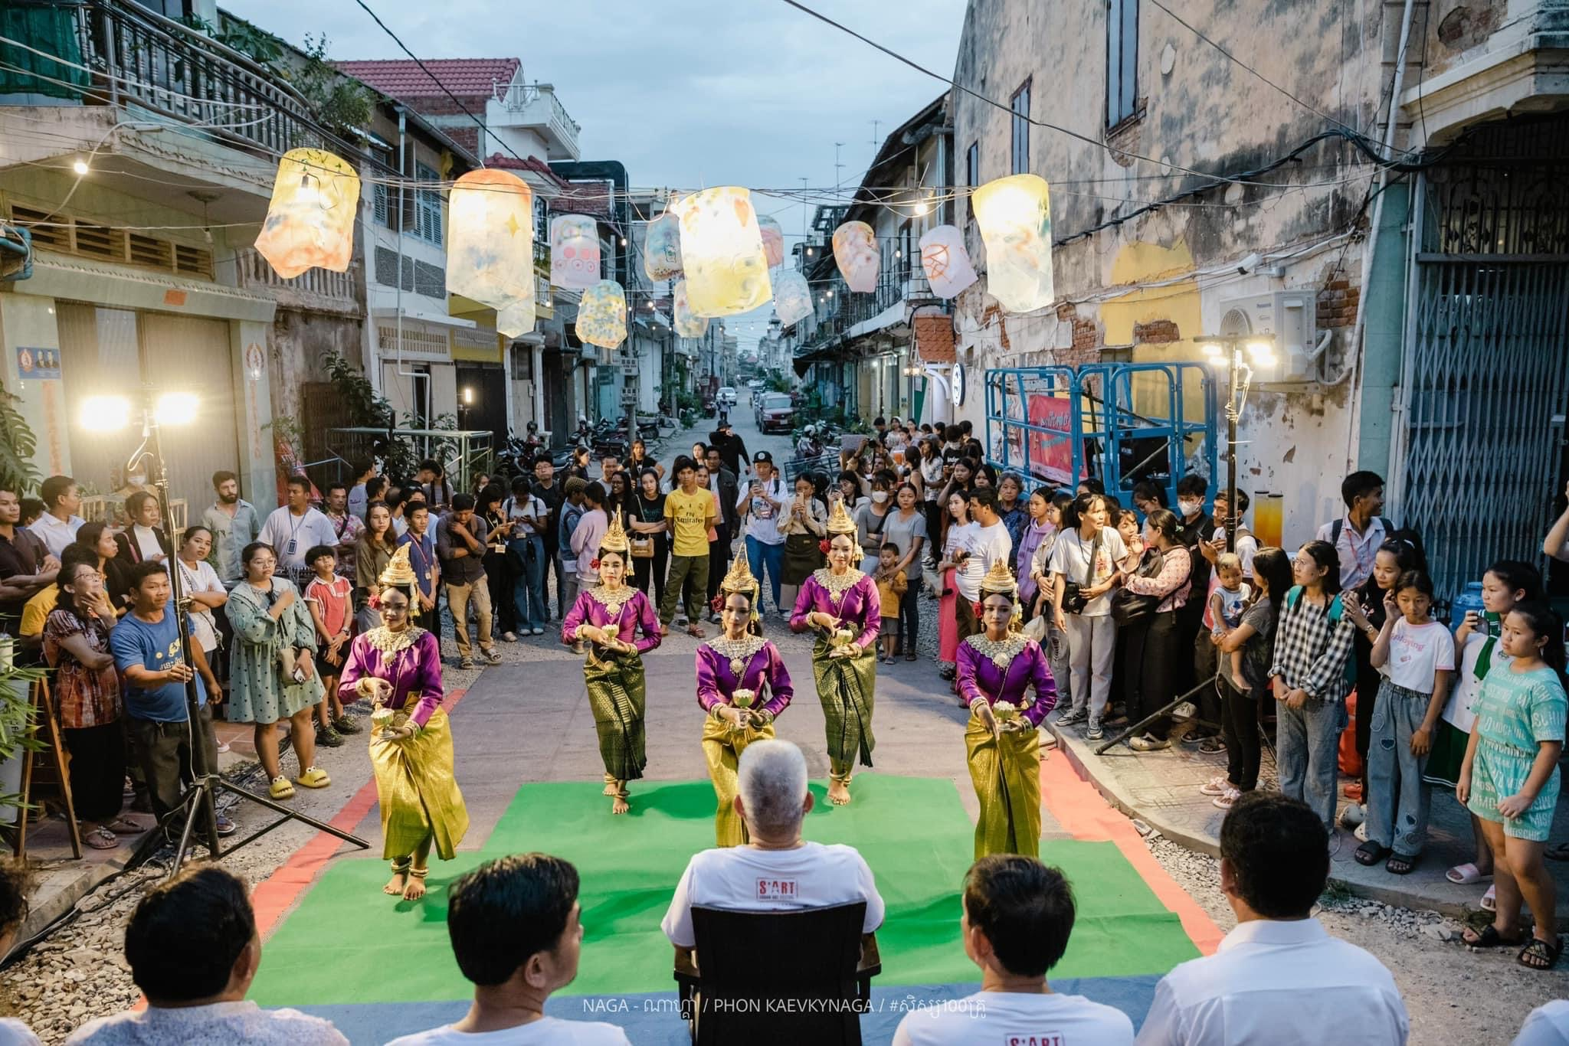
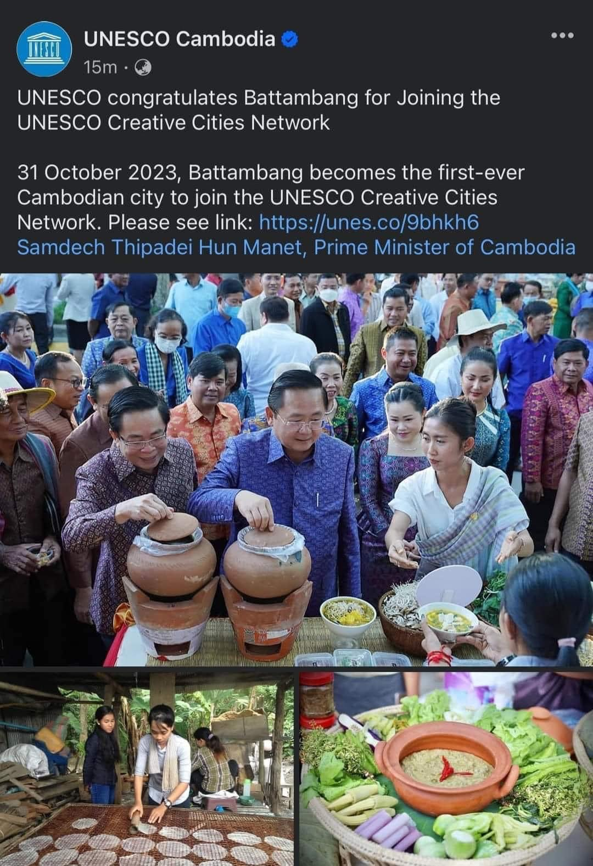
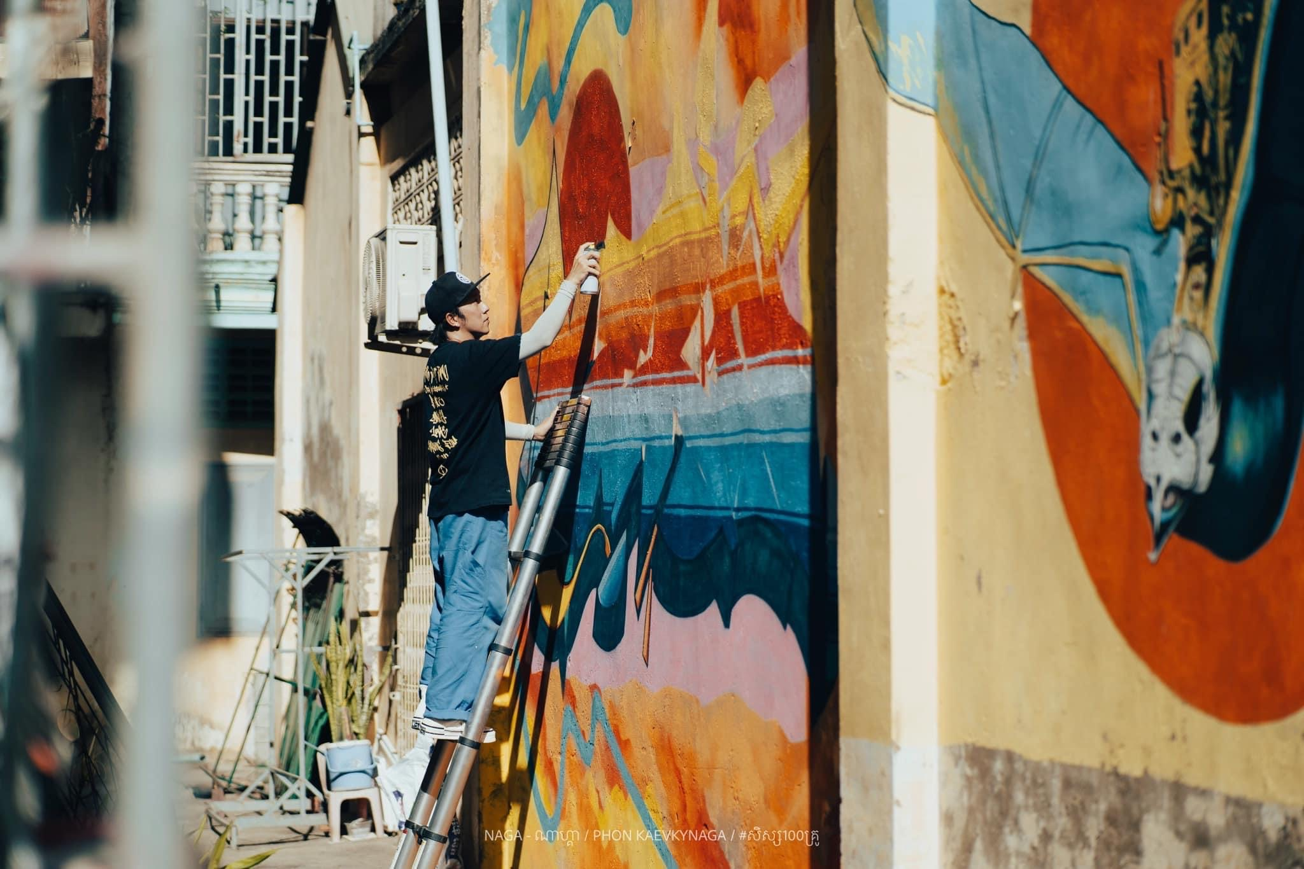
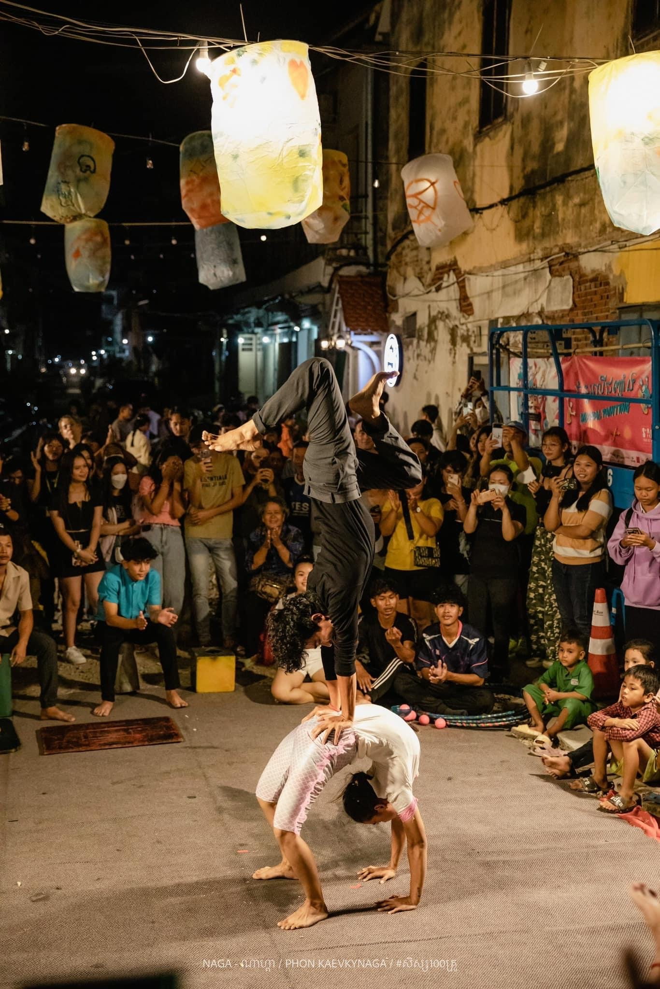
Welcome to Battambang!
Province Area: 11,702 km2
Population: 997,169
Battambang City area: 293 km2
Population: 119,251
Art, Culture, Heritage, Architecture, Gastronomy

Slide 3
“Clean, Green, Smart, Walkable City”

Slide 4
Our Vision “Clean, Green, Smart, Walkable city”
Clean
Successful Solid & Liquid waste management system
Green
City Greening to combat global warming effect counter global warming effect such as extreme urban heat and urban flood
Smart
Using smart technology as solutions & improve citizens’ life quality
Walkable
Create walkable sidewalk and public spaces to encourage people to come outdoor and participate in a more active lifestyle while making sure vulnerable groups are included (elders and disable citizens)

Slide 5
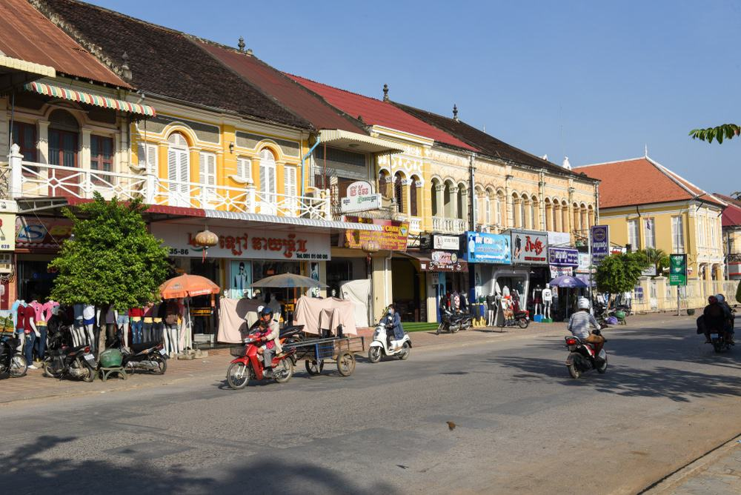
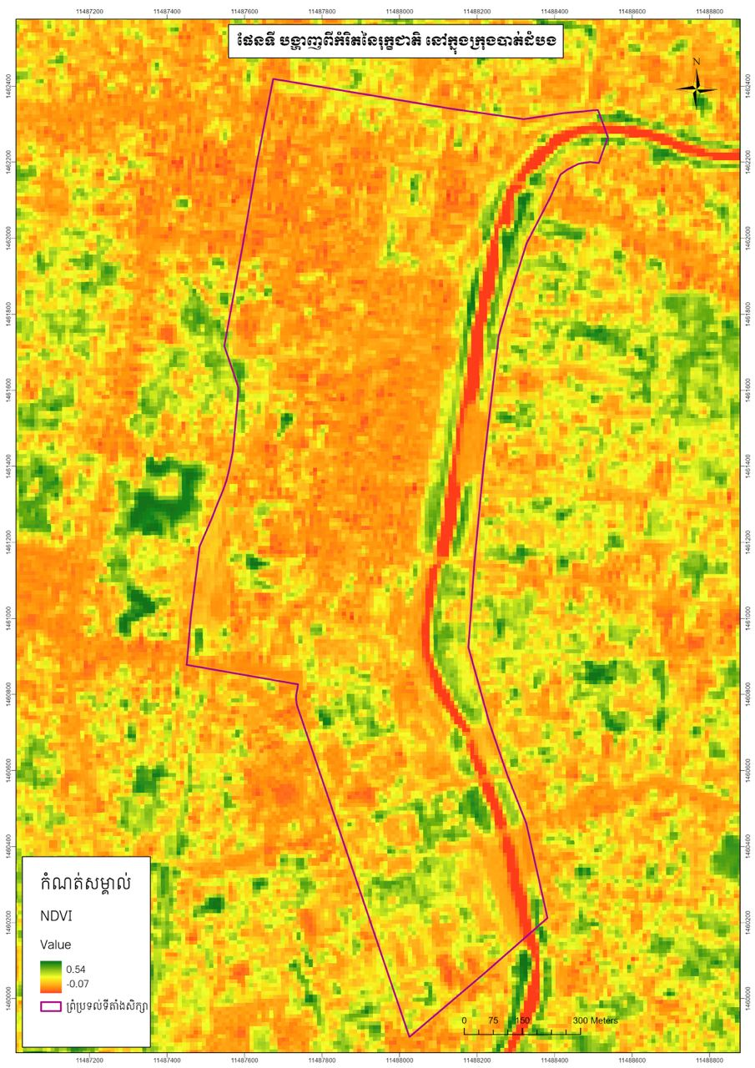
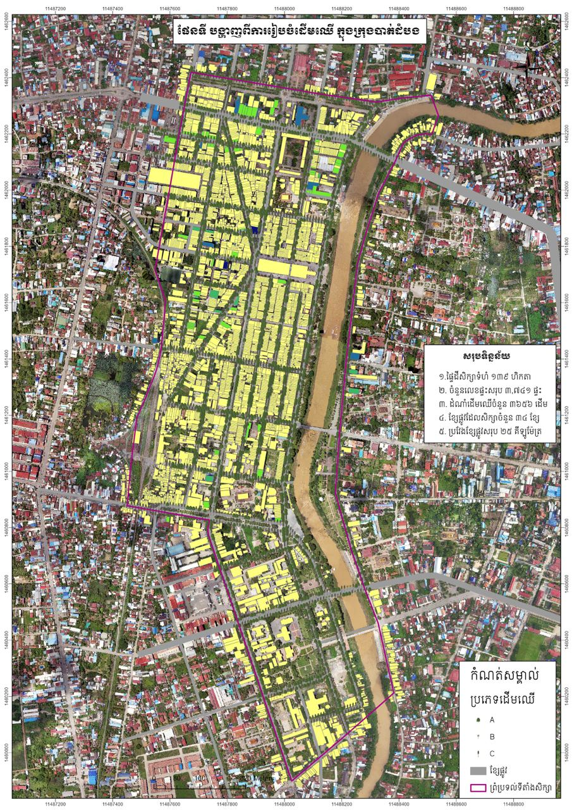
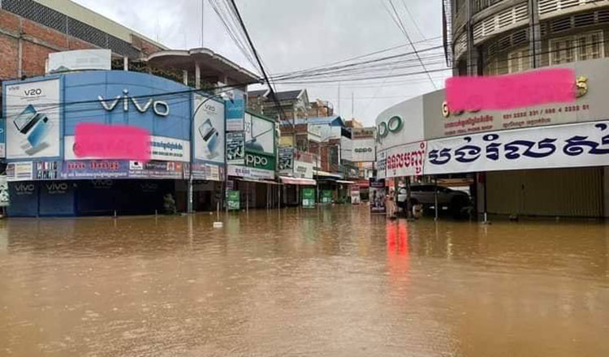
Our Problem: Walkable?
Not Walkable Sidewalk
Extreme Urban Heat Issue
Extreme Urban Flood Issue
Affecting our People, Infrastructure, Economy

Slide 6
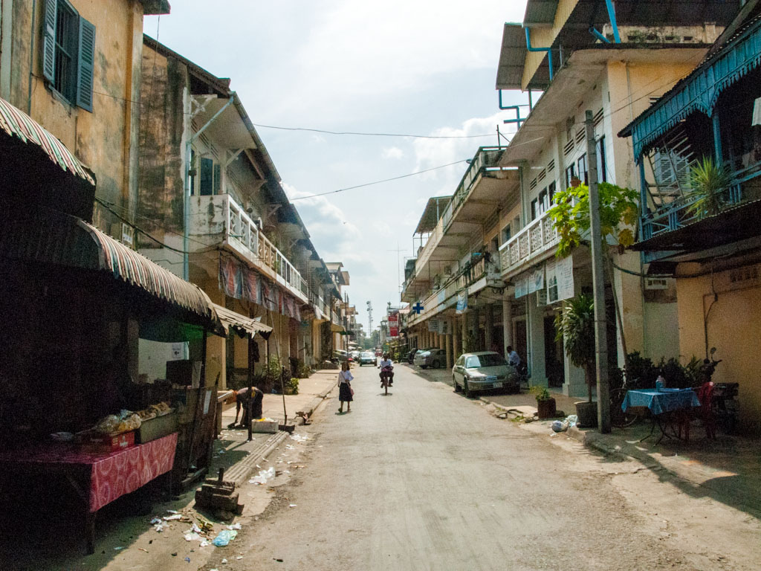
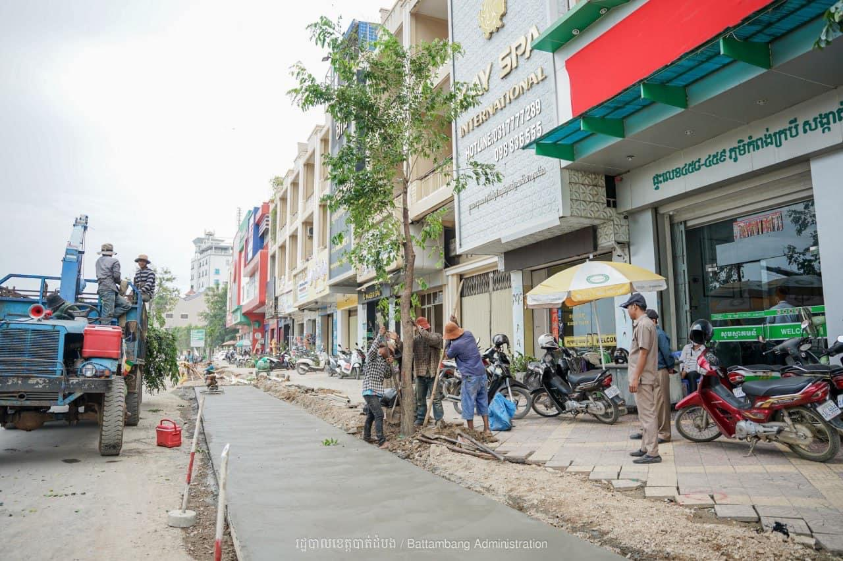
City Greening effort: “One household, One tree Project”
Battambang provincial government plan to plant around 24000 trees in mid 2024, starting this June 2024 which mark the rainy season in Cambodia to try to battle the global warming effect on the province and create a better walking environment in urban area.
Heritage Area :
Narrow road unable to plant trees
Old structure
Hotter than other area

Slide 7
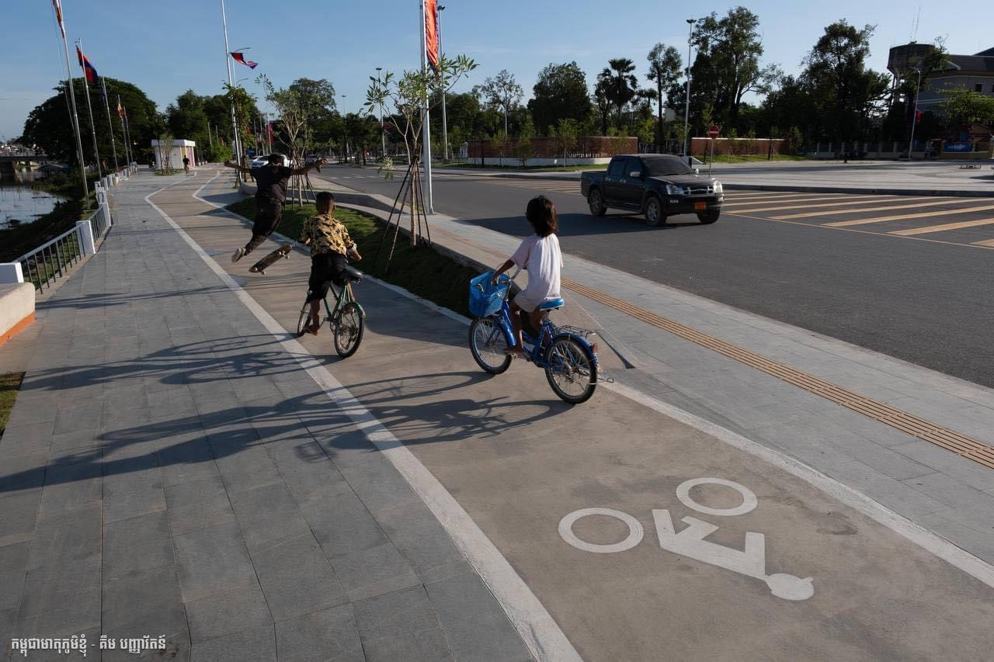
Repurpose/Redesign Old Parks:
Creating reasons to go outdoor and places to be outdoor.
Create accessible lane for disable citizens
Create free bike parking location and bicycle lane to encourage more cycling activities

Slide 8
Implementation challenges
OUR CHALLENGES:
Budget: unable to apply in a larger scale
Local citizen resistance to changes:
Unwilling to give back the sidewalk to the development
Parking on sidewalk due to small parking space
Do not allow trees to be planted in front of their houses
Citizen complain on construction
OUR SOLUTIONS:
Talk to citizen: we have the whole team from provincial government and city government to visit the household
Involve citizen on the project early on by inviting them to the meeting with local government
Celebrate with them

Slide 9
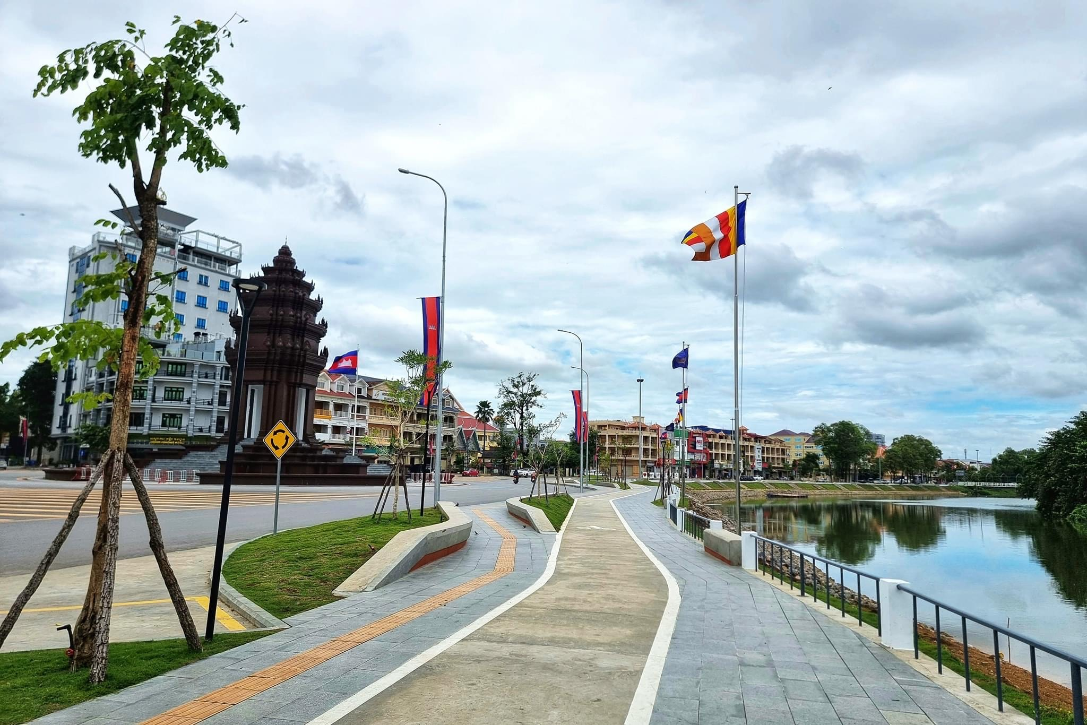
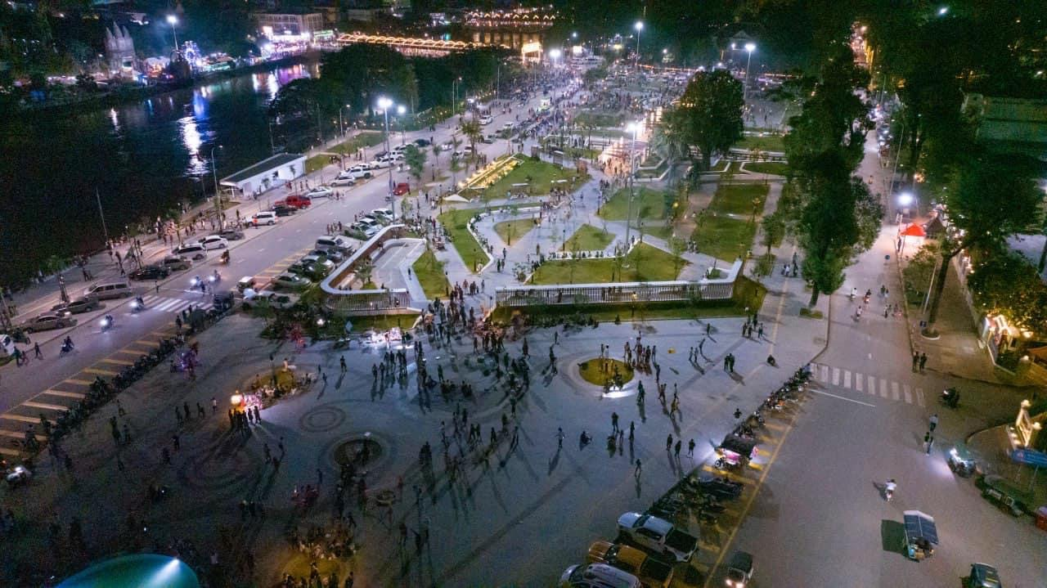
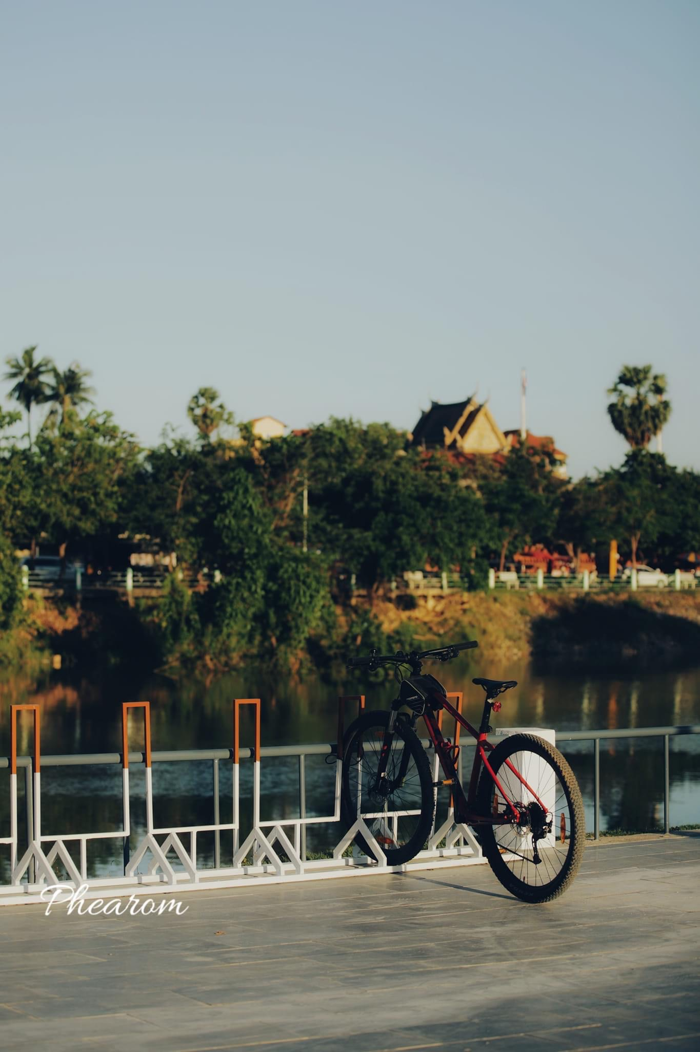
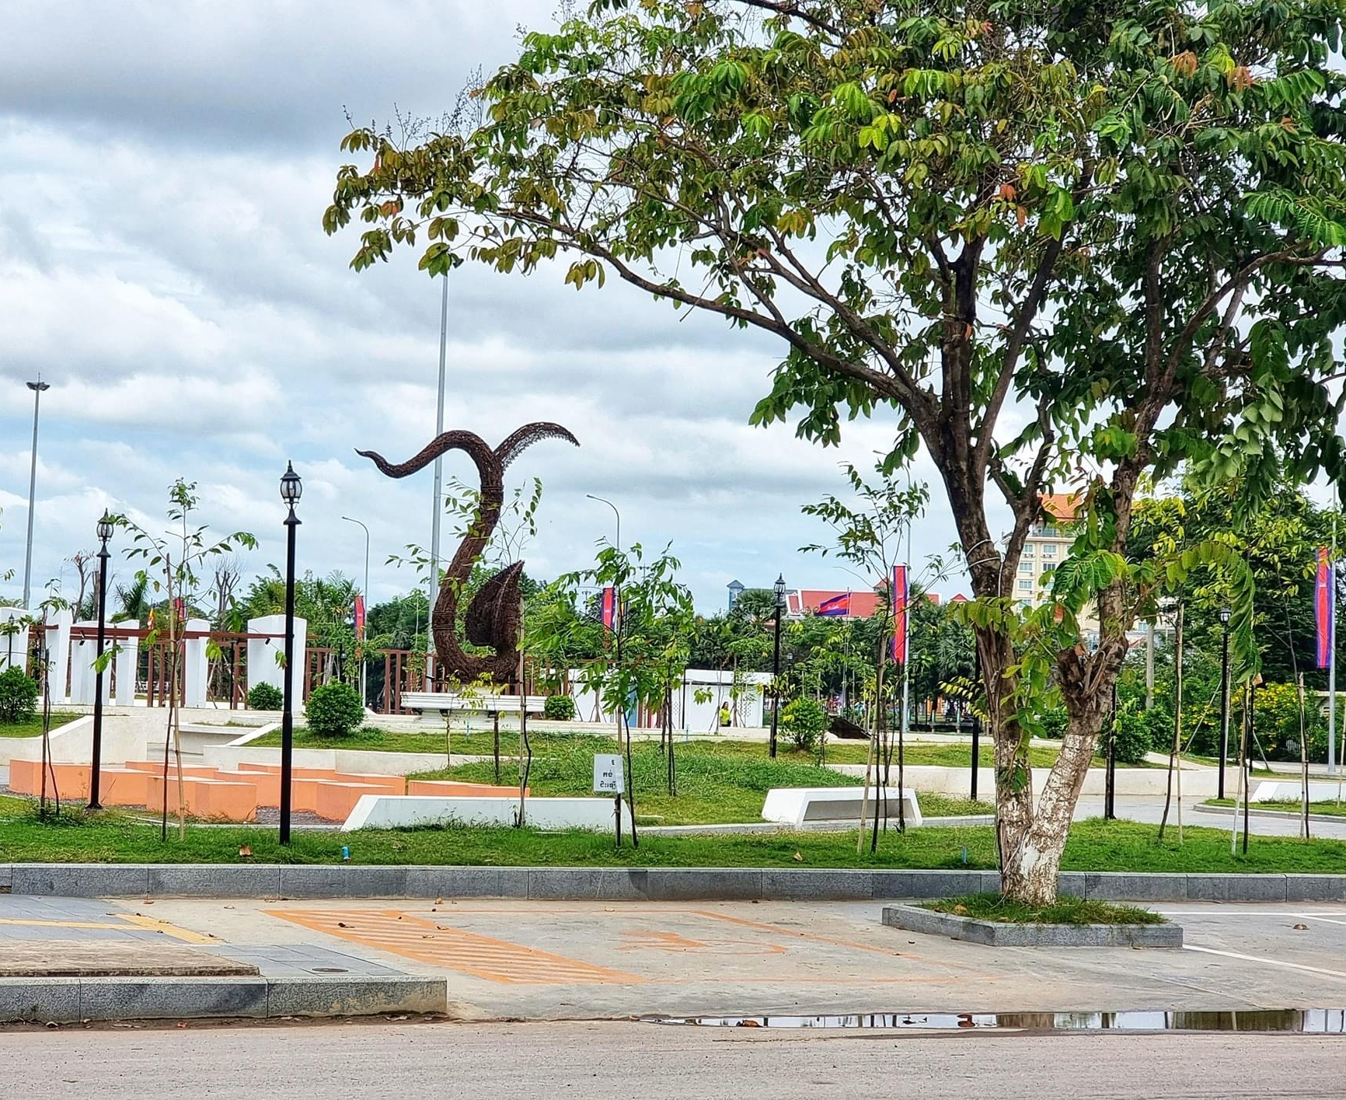

Slide 10
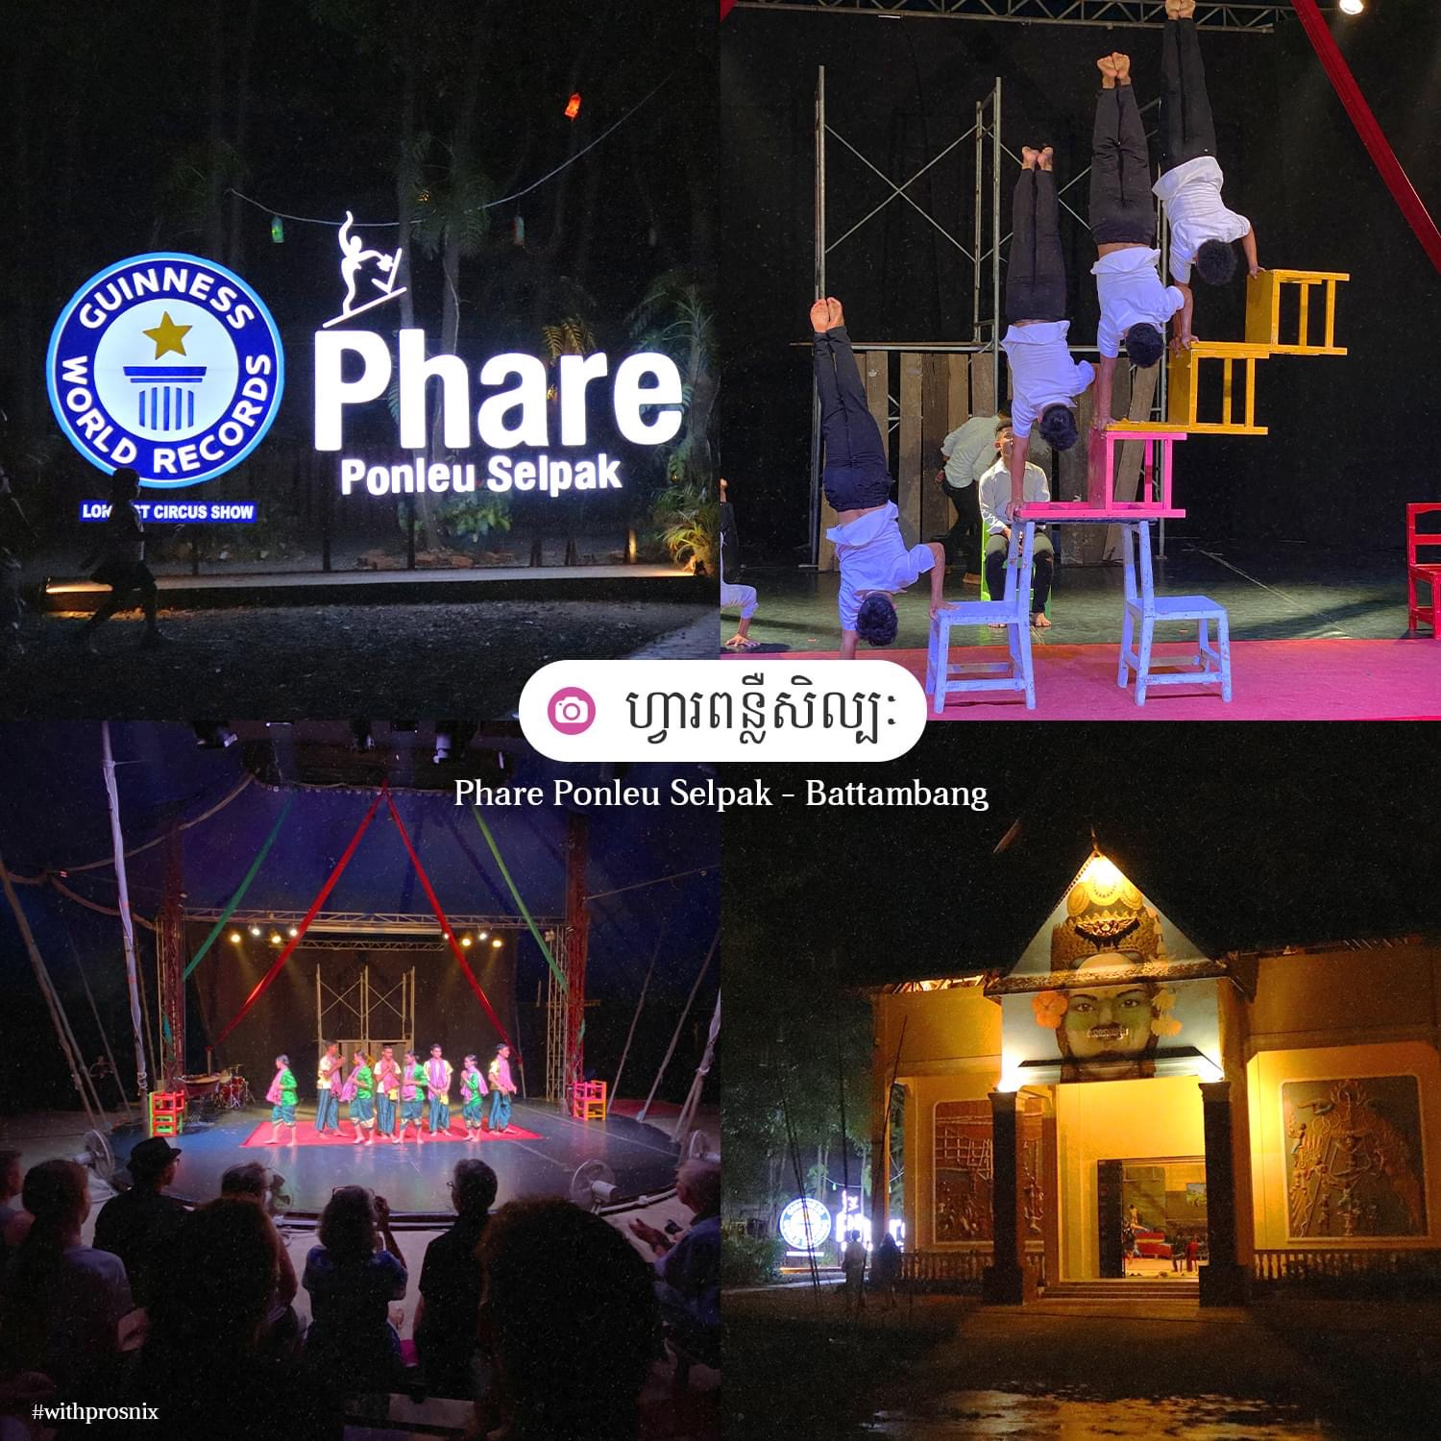
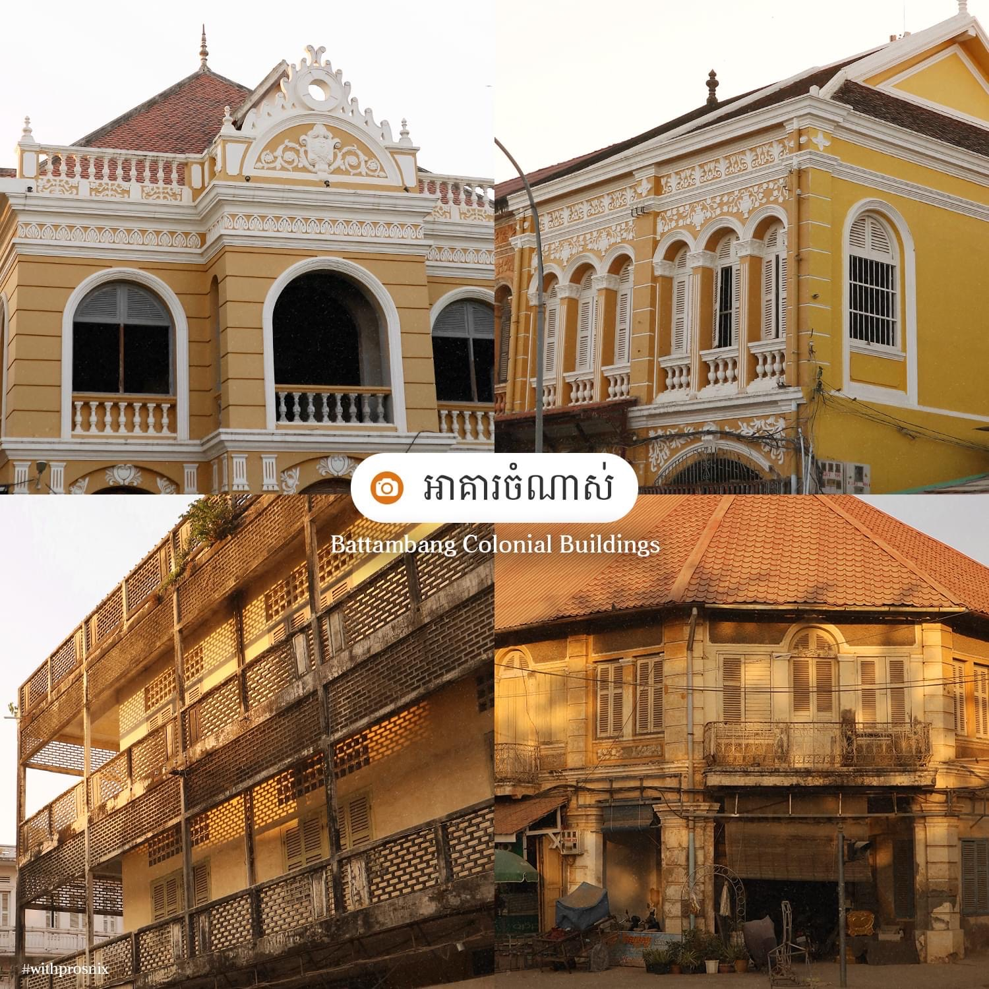
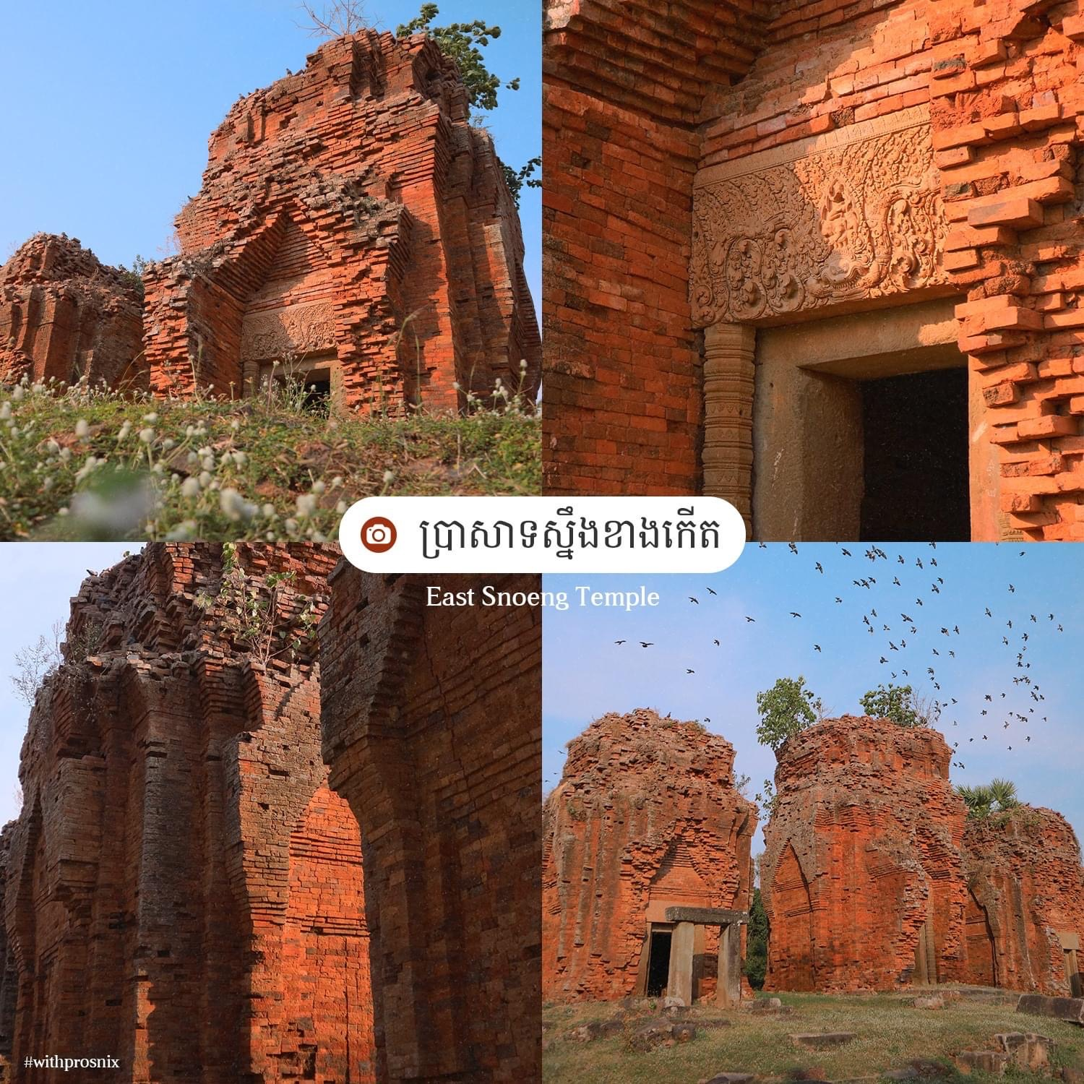
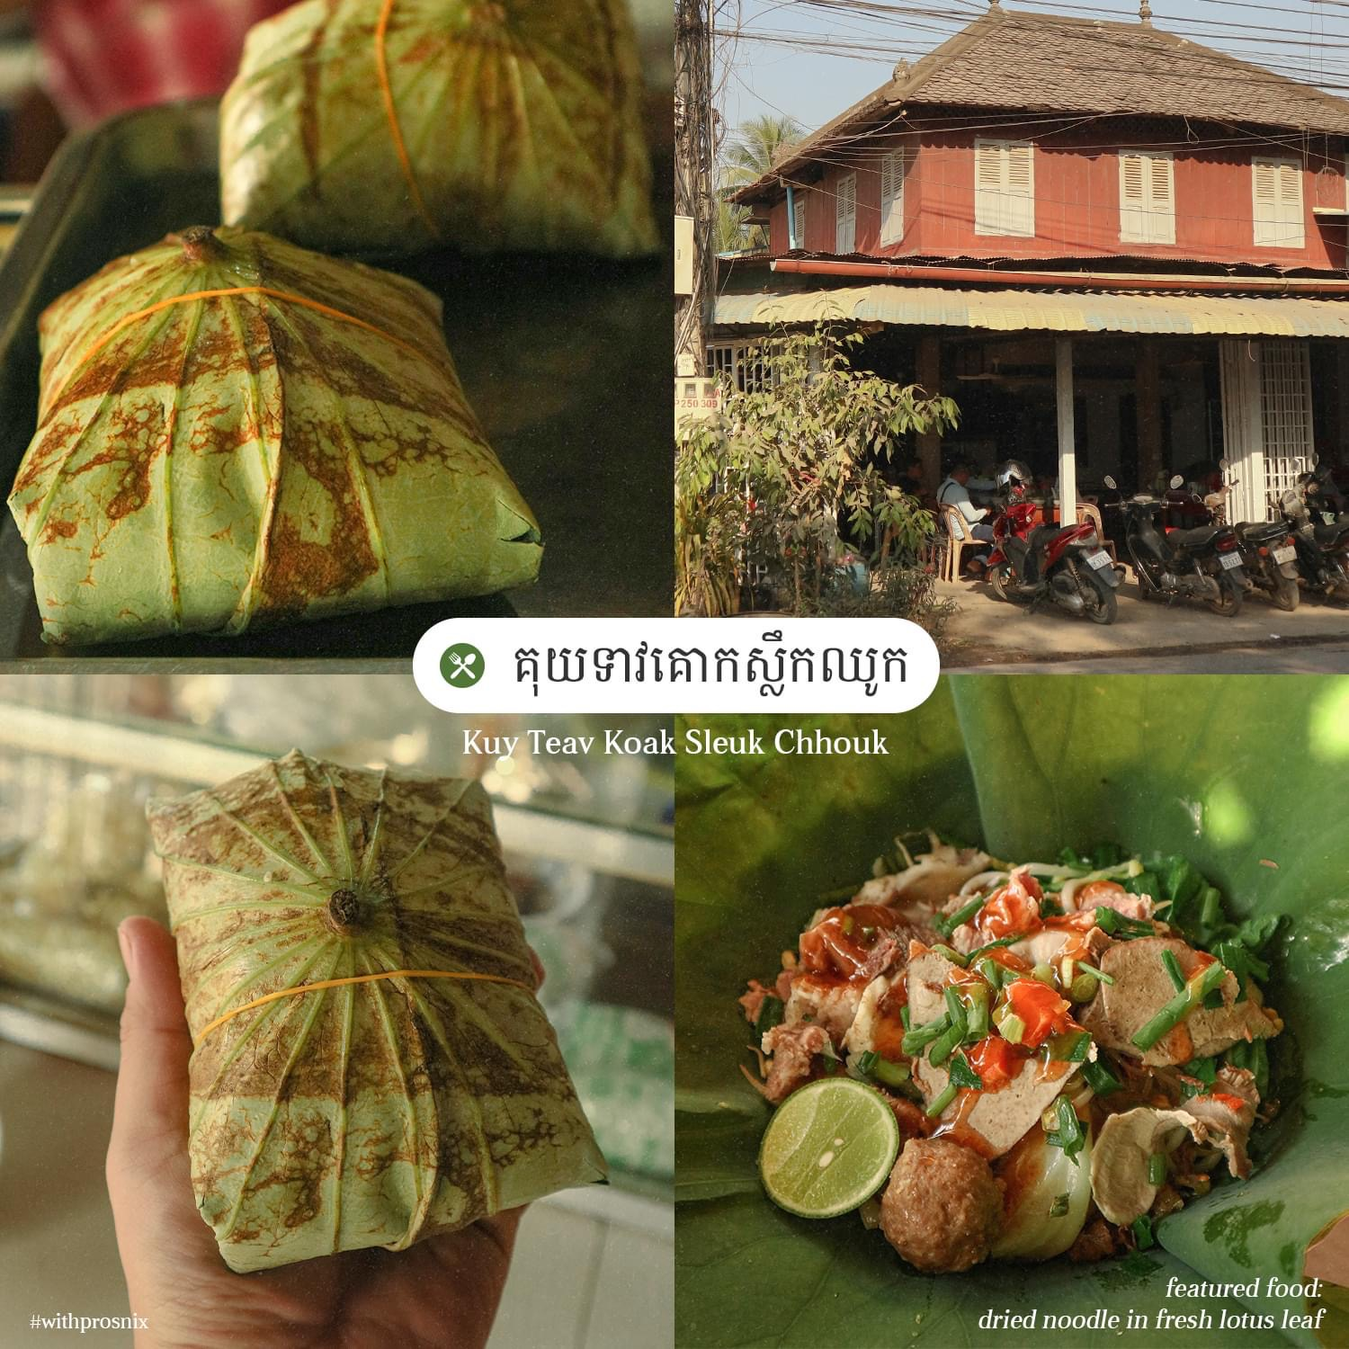
Art, Culture, Heritage, Architecture, Gastronomy
More than 100 tourist destinations including:
Heritage tourism destinations
Cultural tourism destinations
Natural tourism destinations

Slide 11
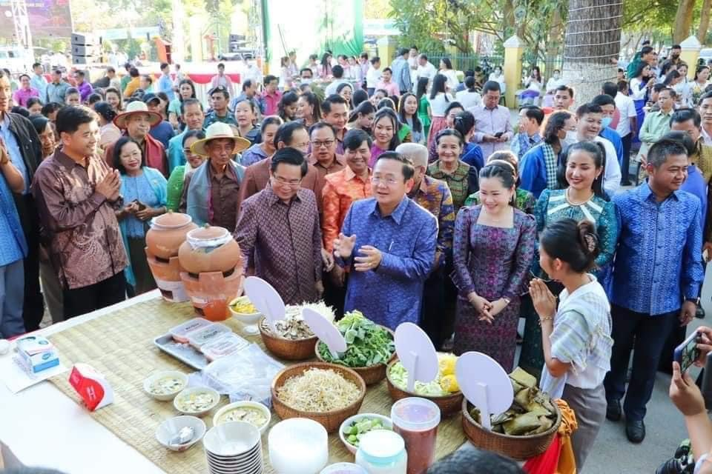
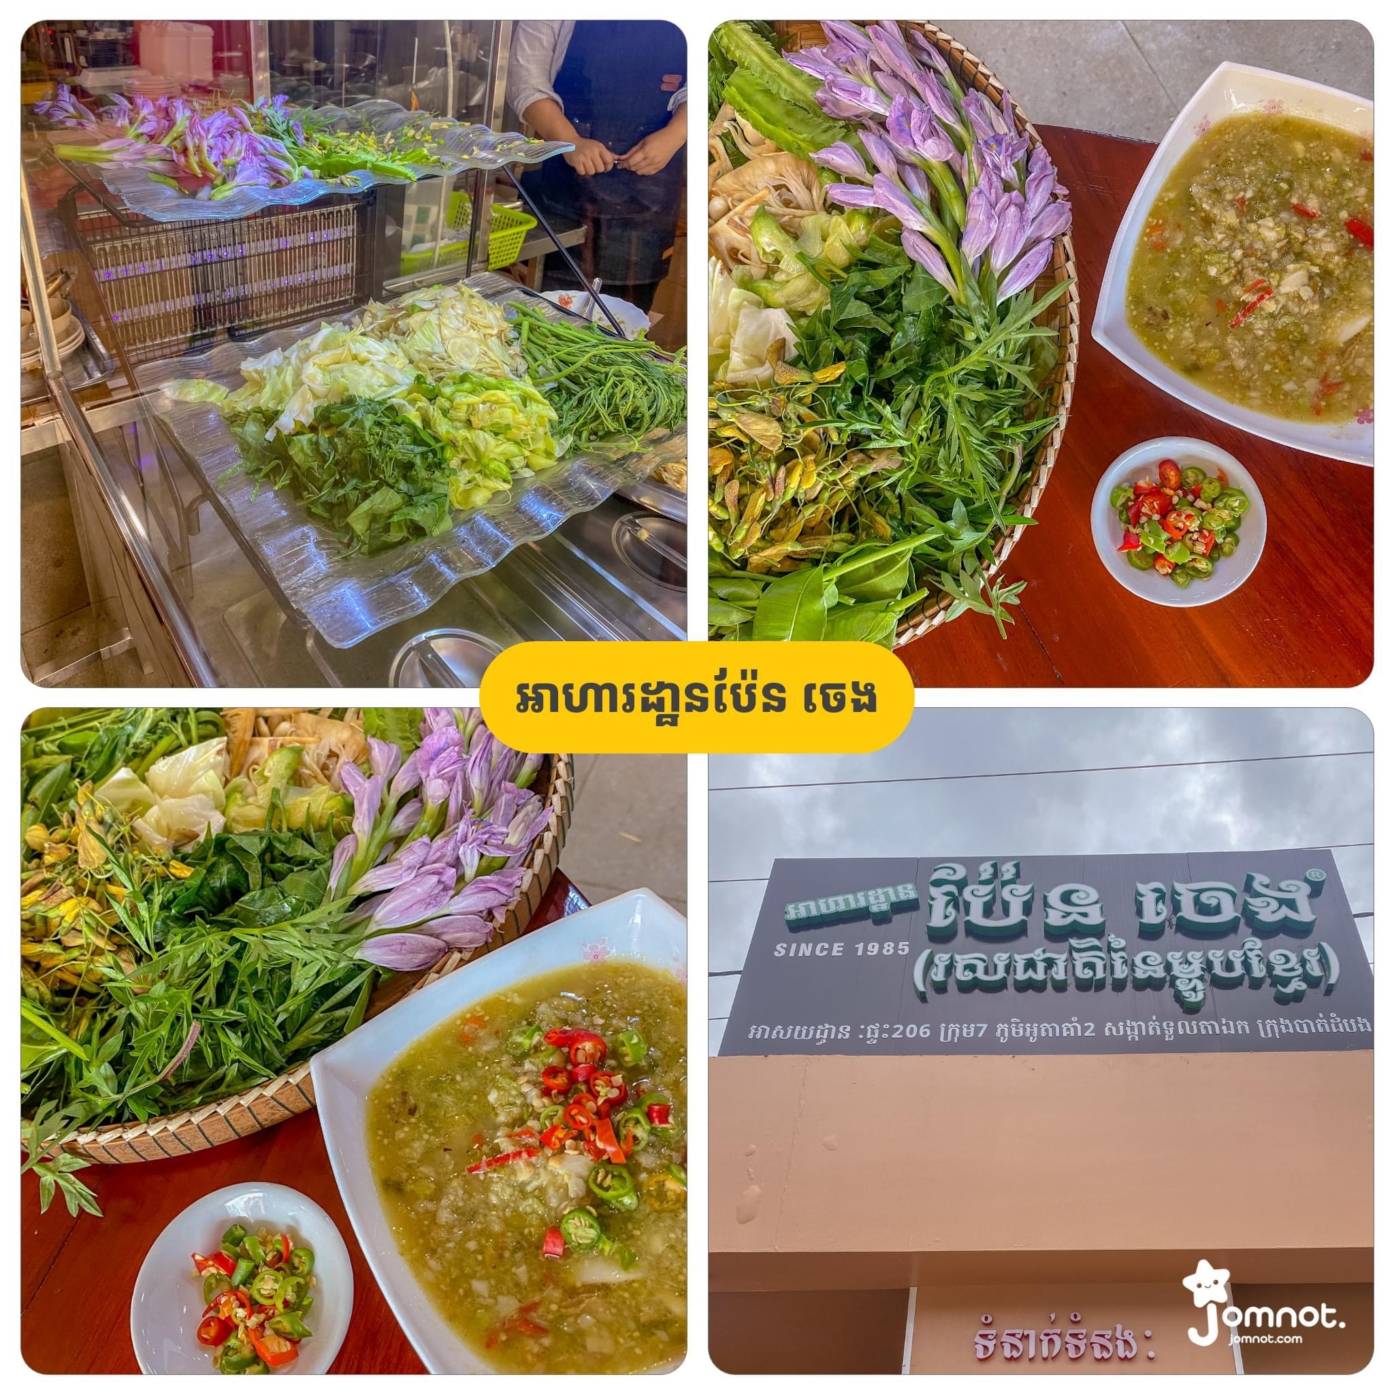
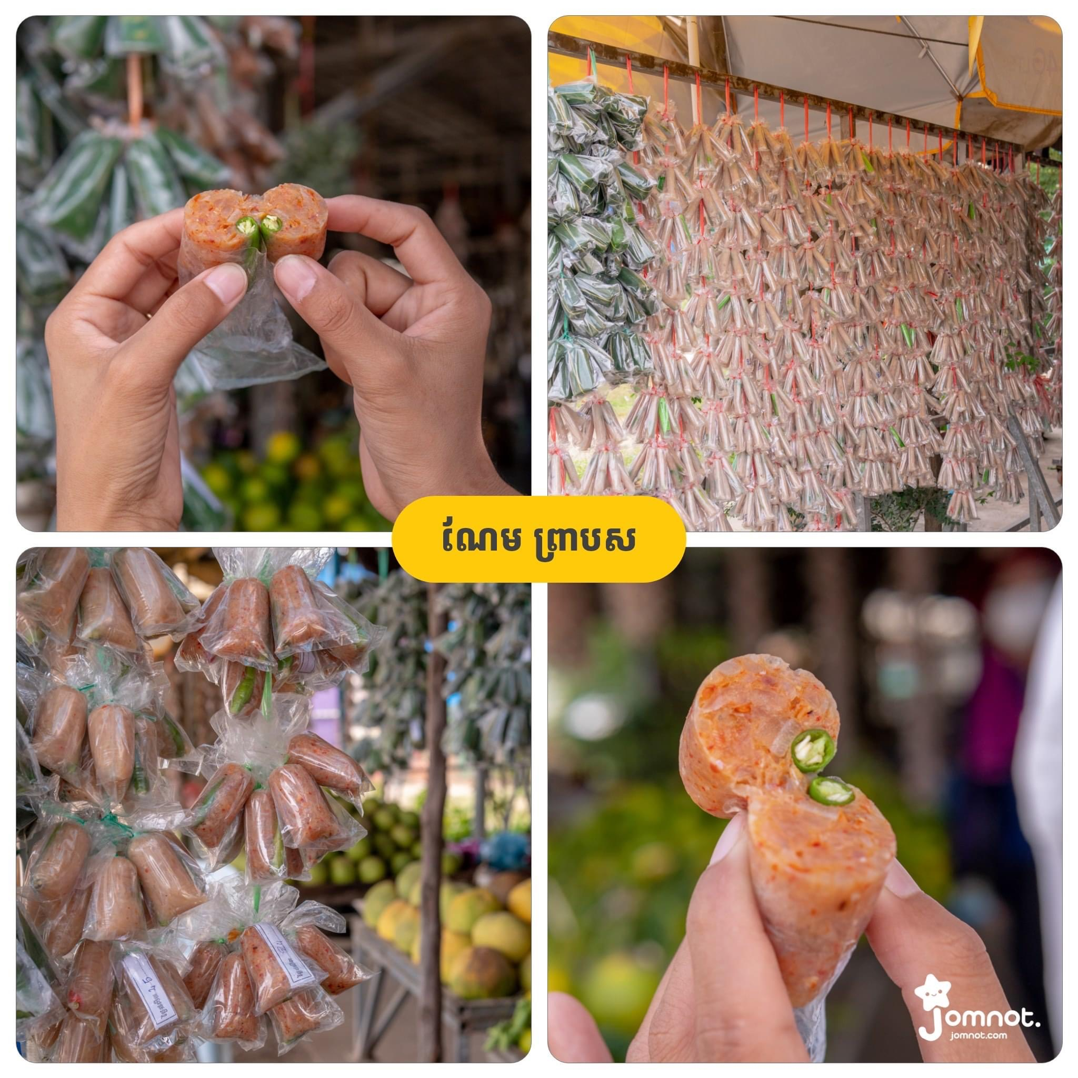
Sustainable tourism in Battambang: Battambang, the creative Gastronomy city of Cambodia

Slide 12
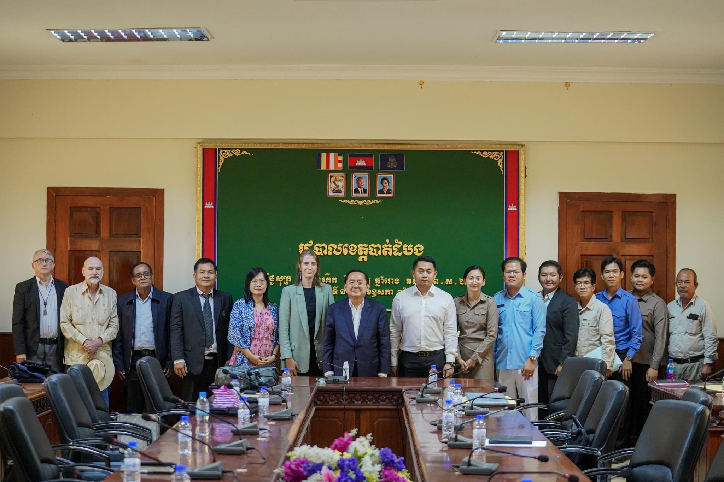
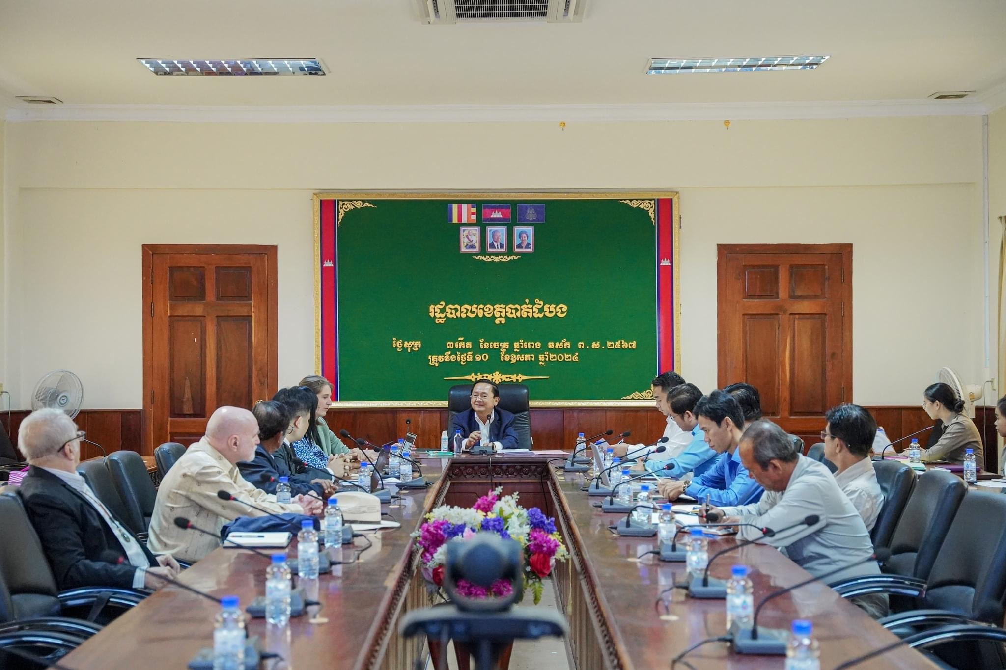
The first steering committee meeting with H.E Sok Lou, the governor of Battambang 10th May 2024, Battambang provincial Hall

